Slide 1
Supporting pupils with Spelling Parents’ Workshop
Sue.calveley@edsential.co.uk 07710706173

Slide 2
Spelling can be fun: How many words can you make from
potatoes

Slide 3
Weekly spellings, can they be fun ?
use a white board
look say cover write check
Put them in a word search

Slide 5
Phonics Terminology
Phoneme: the smallest unit of sound in a word:
c a t, sh o p
Grapheme: a letter or group of letters representing a sound:
sh, igh, t
Split diagraph: has a letter that splits/ comes between two letters in the diagraph:
a-e cake i-e kite

Slide 8
ea in teach
Year 3
ea
each
teach
teacher
teaching

Slide 9
Spell:
difficulty

Slide 10
Words are all around us

Slide 11
Multi-sensory learning

Slide 14
Notes:
ea ream cream scream screaming

Slide 15
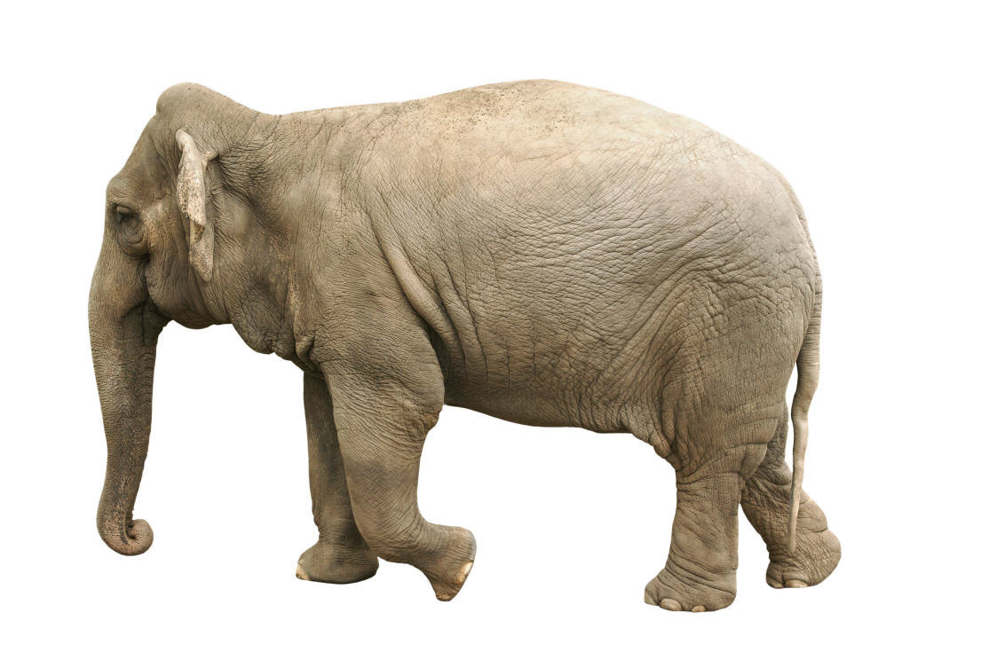
Use of mnemonics
Big
Elephants
Can
Add
Up
Sums
Easily
Notes:
Snakes arrive in dustbins
15

Slide 16
Snakes arrive in dustbins
said

Slide 17
What has a hat in it

Slide 19
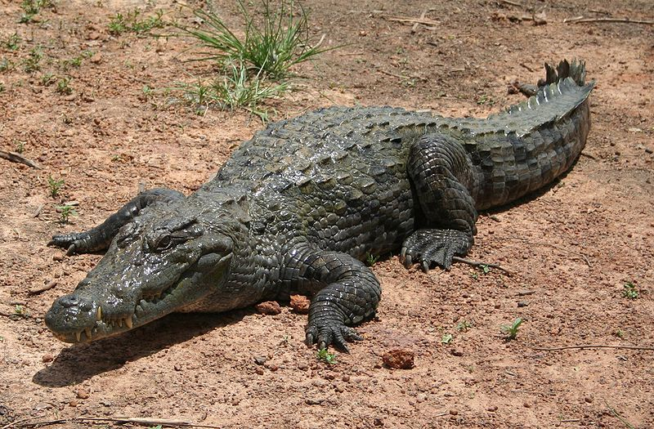
Syllable division
Chunk the word into smaller parts, clap or “chin drop”. How many syllables in each word?

Slide 20
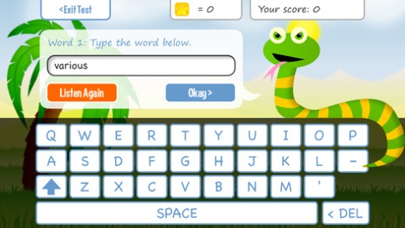
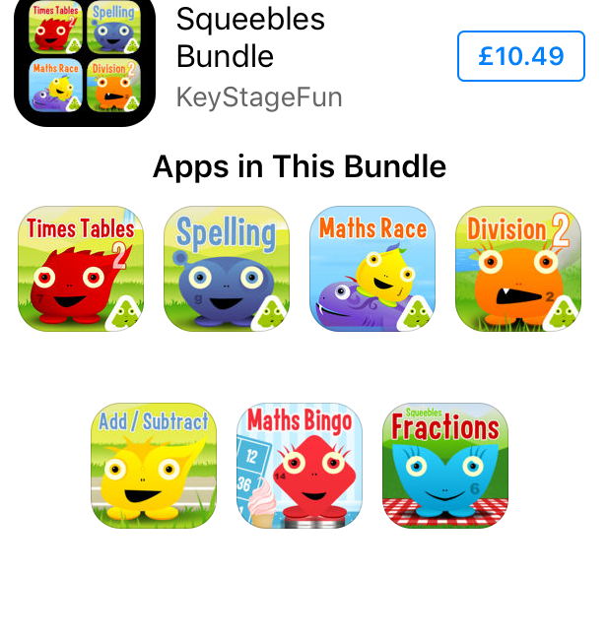
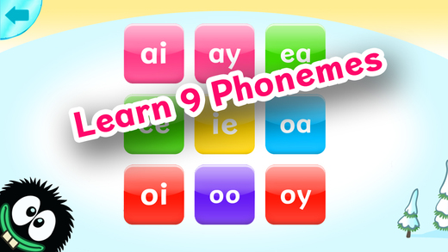
Useful Apps for I pads
**Squeebles Spelling £3.99 (and times tables and

Slide 21
Word cookies free app

Slide 22
Spelling City

Slide 23
Thank you for coming
Did you find this workshop useful?
Please write your comments on the post it notes provided.

