Slide 1
Supporting pupils with Spelling Parents’ Workshop F2 and KS1
Sue.calveley@edsential.co.uk 07710706173

Slide 2
Weekly spellings, can they be fun ?
use a white board
look say cover write check
Put them in a word search

Slide 3
Spelling can be fun: How many words can you make from
tomatoes

Slide 4
What is Letters and Sounds?

Slide 5
Phase Two (Foundation Stage)
6 weeks
Teach phonemes and graphemes for 19 letters
Blend to read VC and CVC words and segment phonemes to spell them
2 syllable words taught.
Teaching of phonetically regular high frequency words is, it, in, at and the “tricky” words the, to, go, no
Letter names
Notes:
You will see on these slides I have put in green the age related expectation – but remember it should be stage not age!
Children need to learn which grapheme correspond to which phonemes and vice versa. ( In order to read an unfamiliar word, a child must recognise and sound out each grapheme not each letter and then merge the phonemes together to make a word.
Blending and Segmenting are reversible key phonic skills.
Letter names – so we need to make sure children understand that the letter name and the phoneme are different

Slide 7
Phase Three
12 weeks
Remainder of the letters
Consonant digraphs (sh, ch, th, ng)
One grapheme for each of the phonemes
Letter names
Notes:
Give each group, handouts for phases 3, 4 and 5. Read the information and discuss where you think some of your children are. Eg, I know Sophie is spelling every word with the phoneme ai as ai so I don’t think she has been taught phase 5 yet. I think she is probably working within phase 3.
Again you can see letter names – this phase is where you should be really bringing in the teaching of the letter names through alphabet songs etc but ensuring that children understand the difference and what a phoneme is.

Slide 8
Teaching phonics in school
Robot arms
Sound buttons
Phoneme frames

Slide 9
Sound buttons

Slide 10
Phoneme frames

Slide 11
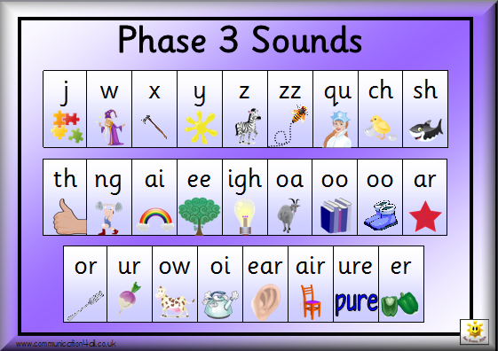
Phase Three Letter Progression
Set 6: j v w x
Set 7: y z zz qu
ch sh th ng
ai ee igh
oa oo
ar or ur
ow oi
ear air
ure er Plus other High Frequency Words

Slide 12
How and where the sound are taught?
PHASE 2
/s/ /a/ /t/ /p/
/i/ /n/ /m/ /d/
/g/ /o/ /c/ /k/
/ck/ /e/ /u/ /r/
/h/ /b/ /f,ff/ /l,ll/ /ss/
PHASE 3
/j/ /v/ /w/ /x/
/y/ /z,zz/ /qu/
/ch/ - chair /sh/ - sheep /th/ - this /ng/ - ring
/ai/ - rain /ee/ - bee /igh/ - night /oa/ - boat
/oo/ - moon, look /ar/ - farm /or/ - for /ur/ - hurt
/ow/ - cow /oi/ - coin /ear/ - dear /air/ - fair
/ure/ - sure /er/ - corner
PHASE 4 – Consolidation of all sounds taught so far.
PHASE 5:
Split Vowel Digraphs
/ay/ - day /oy/ - boy /a-e/ - make
/ou/ - out /ir/ - girl /e-e/ - these
/ie/ - tie /ue/ - blue /i-e/ - like
/ea/ - eat /aw/ - saw /o-e/ - home
/wh/ - when /ph/ - dolphin /u-e/ - rule
/ew/ - new /oe/ - toe
Notes:
Brief overview of how and where the sounds are taught.

Slide 13
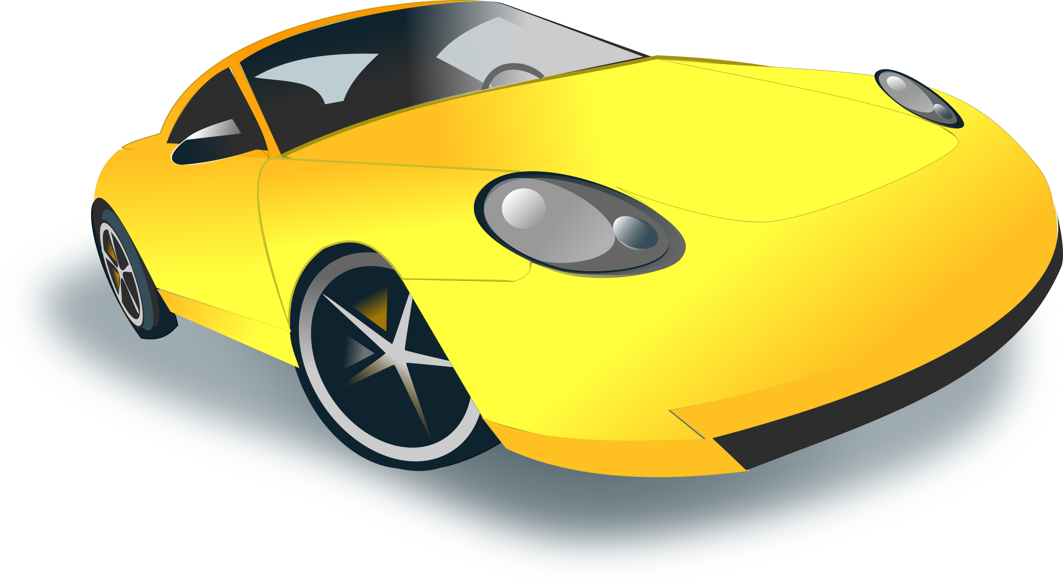
ar in car
tar
star
start
far …..

Slide 14
Spell:
difficulty

Slide 15
Words are all around us

Slide 16
Multi-sensory learning

Slide 20
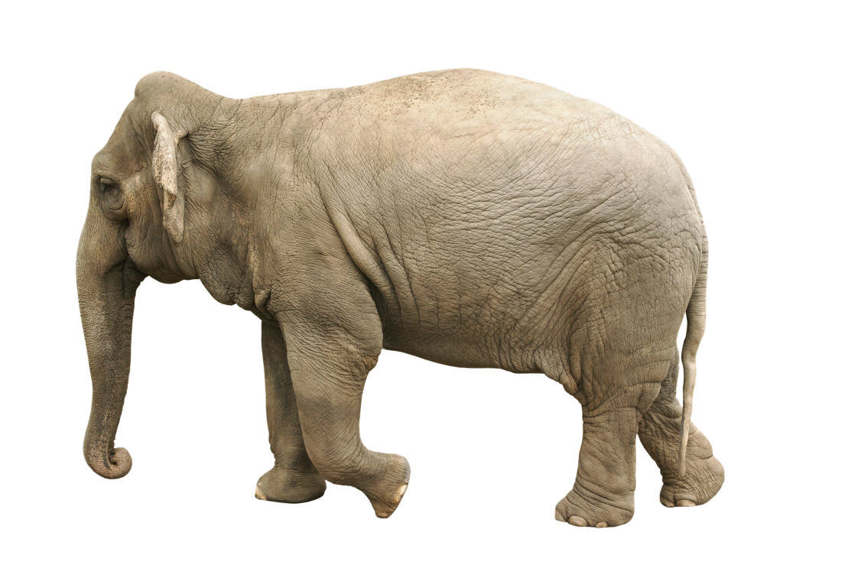
Use of mnemonics
Big
Elephants
Can
Add
Up
Sums
Easily
Notes:
Snakes arrive in dustbins
20

Slide 21
Snakes arrive in dustbins
said

Slide 22
What has a hat in it

Slide 24
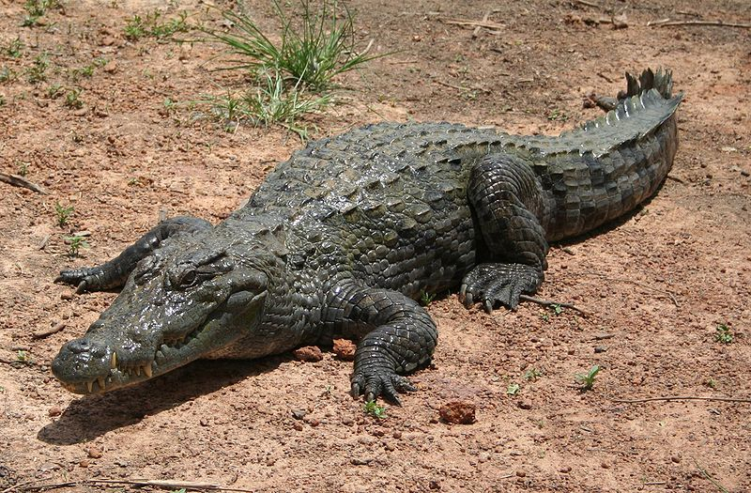
Syllable division

Slide 25
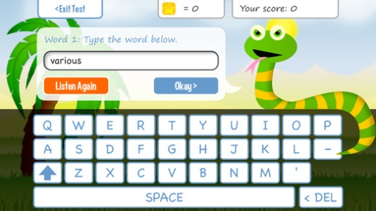
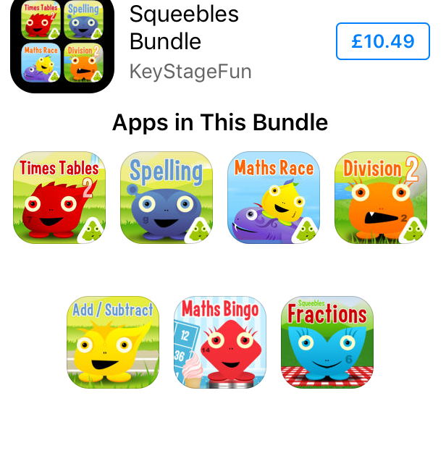
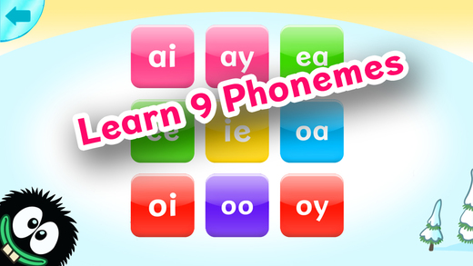
Useful Apps for I pads
**Squeebles Spelling £3.99 (and times tables and

Slide 26
Word cookies free app

Slide 27
Spelling City

Slide 28
Thank you for coming
Did you find this workshop useful?
Please write your comments on the post it notes provided.

